Slide 1

Static and default routing
configuration
Final lab evaluation
Presented by:
Shakir Hussain Itoo(185) Presented to;
Aahib Nazir(182) Miss MEENU LOCHAN
Tamannah
Mukesh
Suresh

Slide 2
Topics
•Routing
Static Routing
•Default routing
•Configuration of both static and default routing

Slide 3
ROUTING
Routing is the process of selecting a path for traffic in a network or between or across multiple networks.Broadly routing is performed in many types of networks , including circuit switched networks , such as the public switched telephone networks, and computer networks, such as the internet.
Types of routing :
Default routing, Static routing, and Dynamic routing

Slide 4
STATIC ROUTING
→Static routing is a i.e, of non - adaptive nature that occurs when a router uses a manually configured routing entry, rather than information from dynamic routing traffic.
→In many cases static routers are manually configured by a network administrator by adding in entries into a routing table.
→Unlike dynamic routing, static routes are fixed and do not change if the network is changed or re-configured.

Slide 5
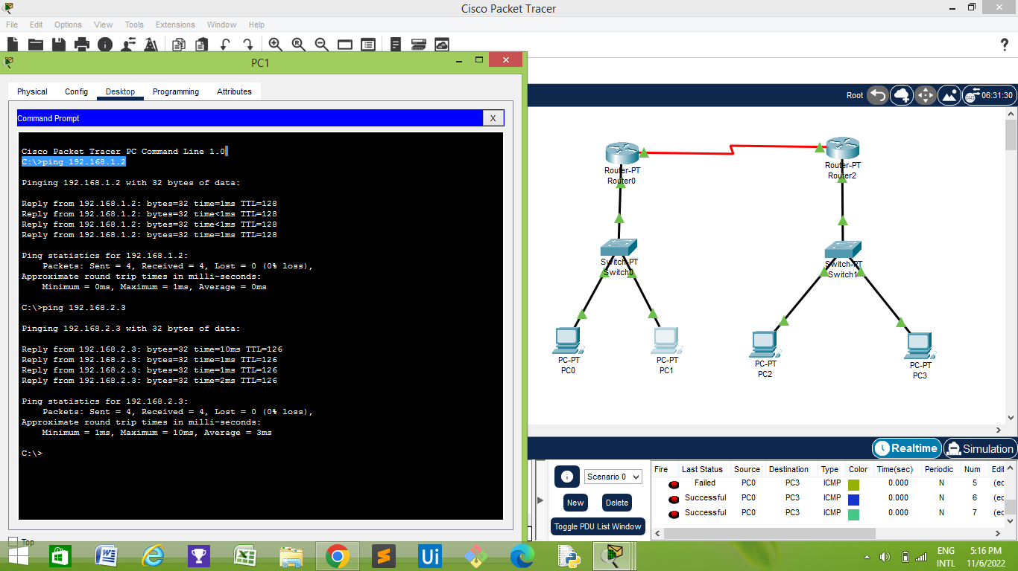
Implementation of static routing
Configuration of both static and default routing

Slide 6
DEFAULT ROUTING
→Default routing is used to send data packets to an unknown target to a single next-hop address.
→Default routing is used while networks addresses a single go-out point.It is also useful while the bulk of transmission networks need to transmit the information to the equal hop devise.
→Default routing protocol are used in the internet/network where destination address is unknown.
→ Also known as slow routing becoz……..

Slide 7
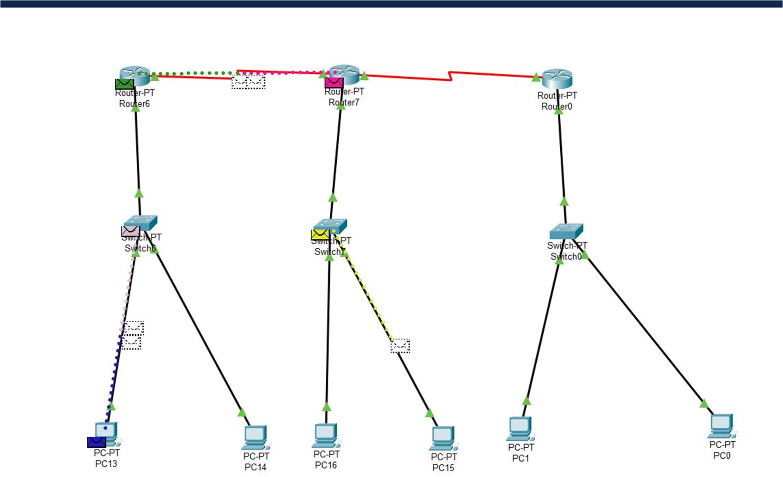
Implementation of default routing

Slide 8
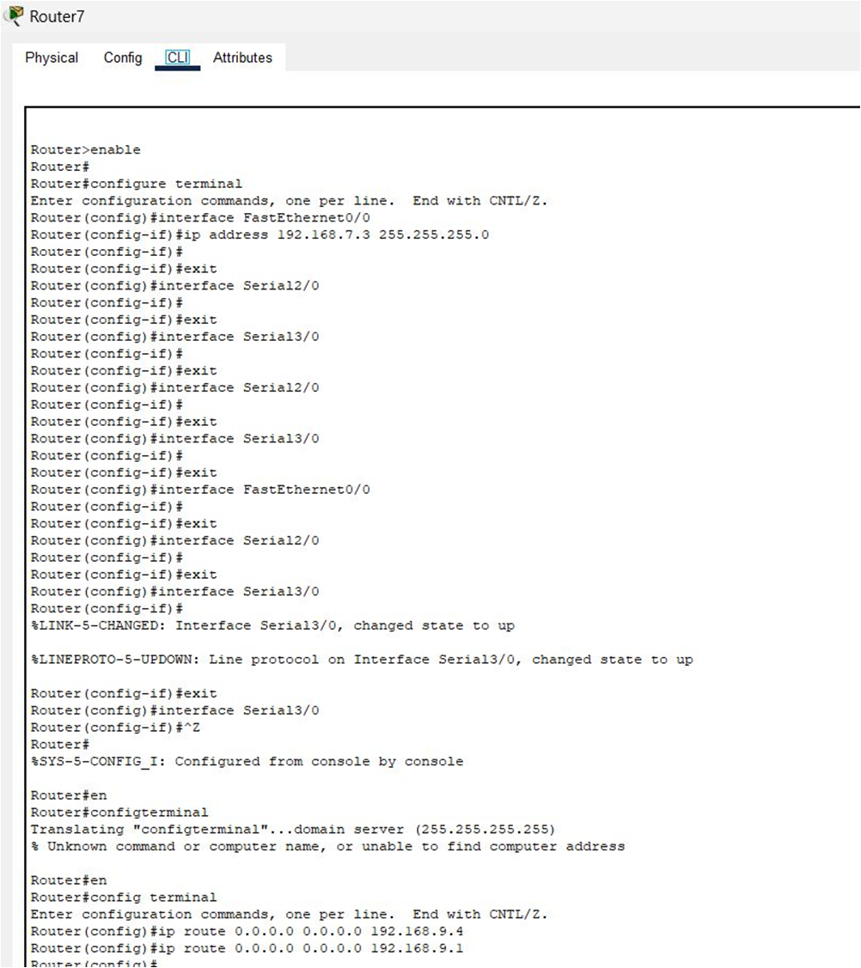

Slide 9
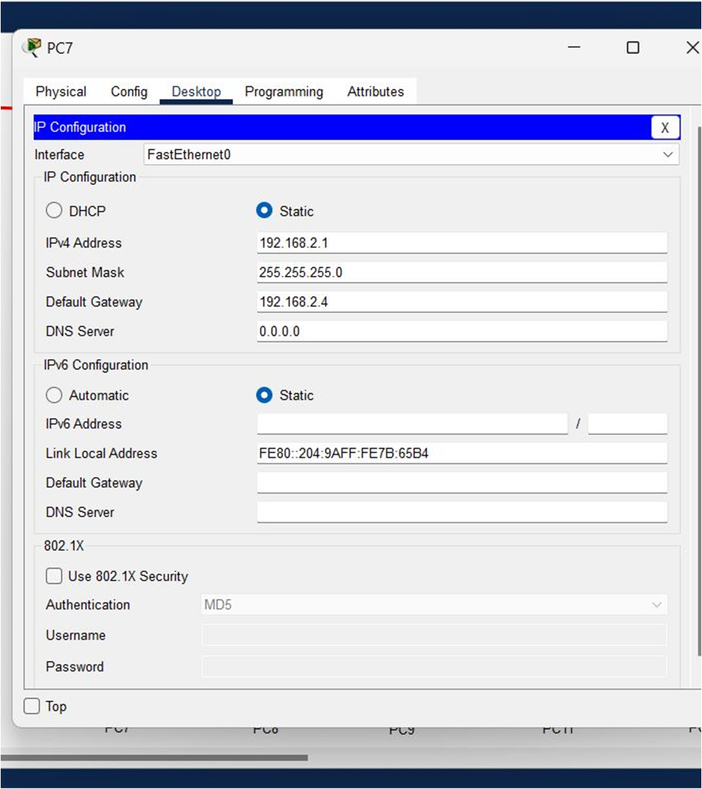

Slide 10


